Slide 1
Department of MCA
QR BASED COLLEGE CANTEEN MANAGEMENT SYSTEM Under the Guidance of Dr MNV KIRAN BABU
By :
Student Name T ROHITH REDDY
Roll No. 2401600139
Dept. of MCA. KL University.

Slide 2
Introduction
Problem statement
1. Traditional canteen systems rely on manual ordering and billing, causing delays and inefficiency.
2. Students face long queues during peak hours, leading to time wastage.
3. Manual record keeping results in errors, lack of transparency, and poor management.
Why this project?
To reduce waiting time and provide a fast, QR-based ordering system.
To minimize human errors in billing and order processing.
To improve efficiency through digital records and real-time management.

Slide 3
Objectives
What you aim to achieve
To develop a QR-based system for quick and easy food ordering in the college canteen.
2. To automate billing and order management for improved accuracy and efficiency.
3. To provide a user-friendly platform for students and staff with real-time order tracking.

Slide 4
Literature Survey
Many existing canteen management systems are based on manual or semi-digital processes, which are time-consuming and less efficient. Some web-based systems have been developed to simplify ordering, but they often lack real-time tracking and automation features. Research shows that digital solutions improve service speed and reduce human errors. The use of QR code technology has gained popularity for contactless transactions and easy access to services. Online payment integration further enhances convenience and security. These advancements highlight the need for a smart, QR-based canteen management system to improve overall efficiency and user experience.

Slide 5
Methodology
Approach used
1.The system uses a web-based approach integrated with QR code technology for easy access. 2. Users scan the QR code to view the menu and place orders digitally. 3. The backend processes requests and stores data in a database. 4. This approach reduces manual work and improves efficiency and accuracy.

Slide 6
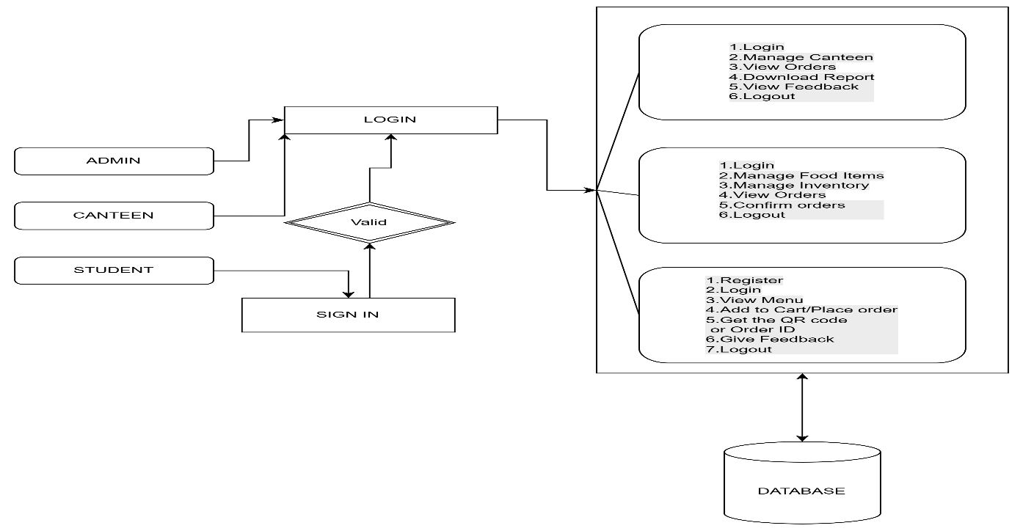
Flowchart / architecture diagram

Slide 7
Technologies Used
Frontend: HTML, CSS, Bootstrap
Backend: Python (Flask)
Database: MySQL
Technologies: QR Code, Web Application
Tools: VS Code, XAMPP

Slide 8
Implementation
Modules:
Admin Module:
Login: Admins can securely log in using authorized credentials to access system features.
Canteen Staff Management: Admins can add, view, update, or remove canteen staff from the system.
Dashboard Management: A graphical dashboard displays real-time statistics including:
Report Generation: Admins can download revenue and user data in Excel format for analysis and record-keeping.
Feedback Management: Admins can view feedback submitted by students for service improvement.
Logout: Allows the administrator to safely exit the session.
Canteen Module:
Login: Canteen staff can log in securely to manage daily operations.
Order Management: Staff can view pending and confirmed orders on a dashboard and update order status after delivery.
QR Code / Order ID Confirmation: Orders can be retrieved and confirmed quickly using QR code scanning or by entering the Order ID.
Food Item Management: Staff can add, delete, or update available food items on the menu.
Inventory Management: Staff can track stock levels and update item quantities in real time.
Logout: Allows staff to log out securely after completing tasks.
Student Module:
Login: Students can securely log in to place orders and manage their accounts.
Menu Browsing: Students can view the list of available food items with prices and descriptions.
Order Placement: Students can add items to a cart, make payments, and receive an Order ID and a QR Code for order pickup.
Order History: Students can track previous orders and payment statuses.
Feedback Submission: Students can submit feedback to improve services.
Profile Management: Students can manage their personal and contact information.
Logout: Students can log out safely after using the system.

Slide 9
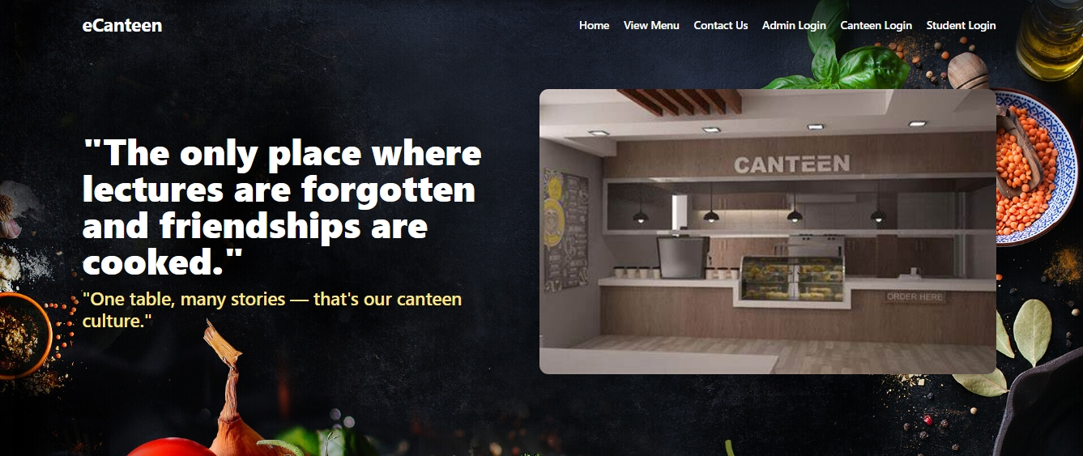
Results & Output
Successfully implemented QR-based canteen ordering system
Users can scan QR code, view menu, and place orders
Orders are processed quickly with reduced waiting time
System shows efficient performance and improved user experience

Slide 10
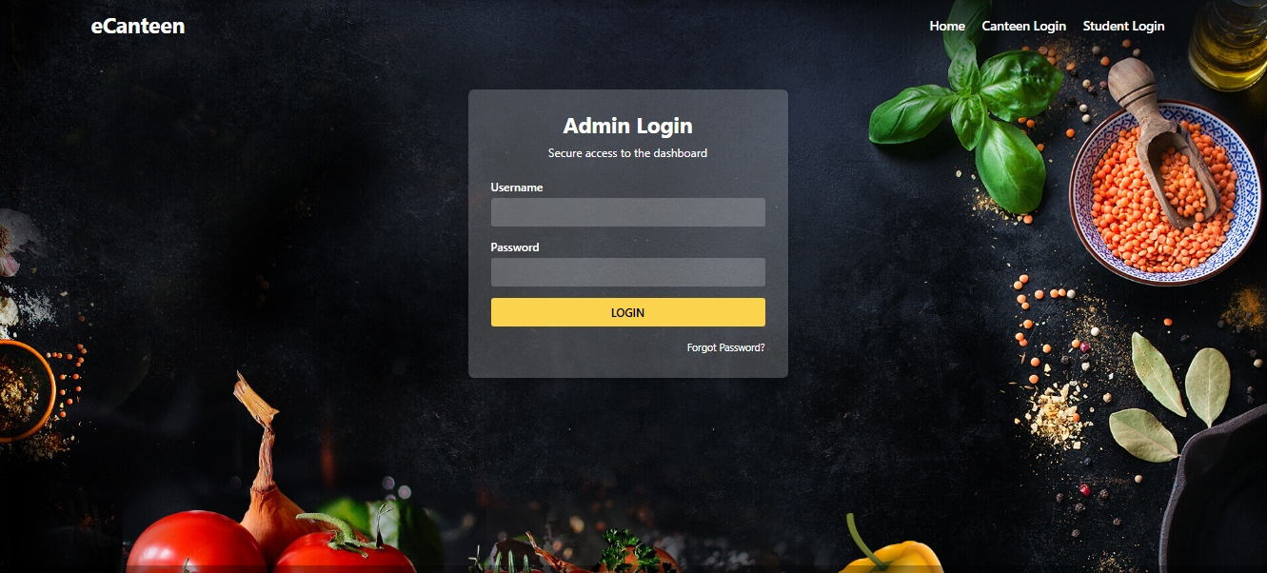
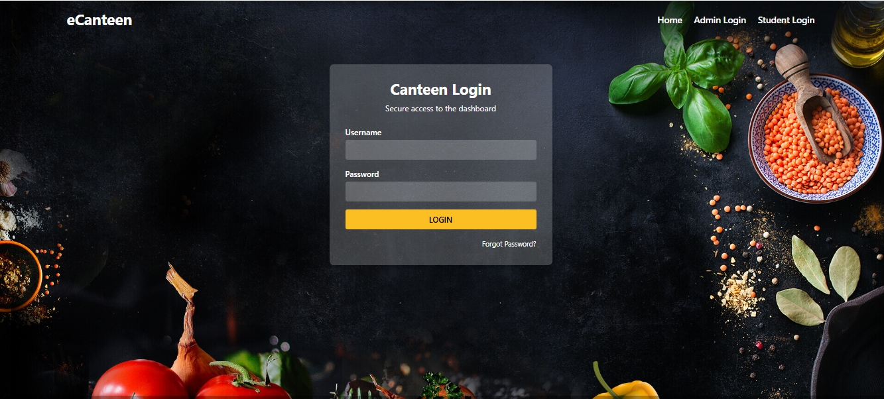

Slide 11
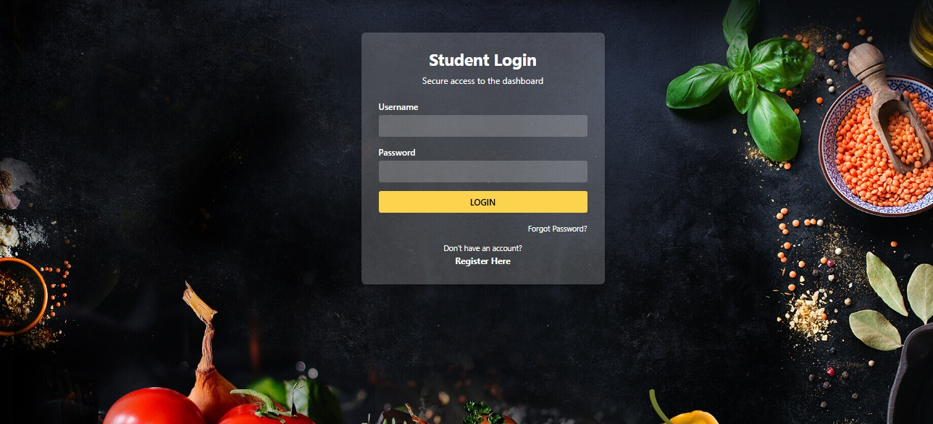
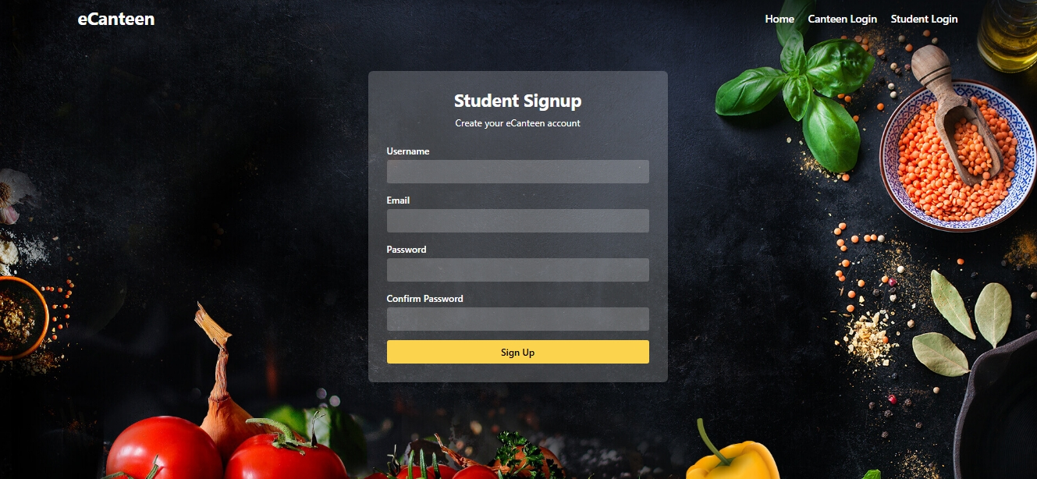

Slide 12
Advantages
Reduces waiting time and avoids long queues
Provides fast and contactless ordering using QR code
Minimizes human errors in billing and order management
Improves efficiency with digital records and real-time trackin

Slide 13
Limitations
Requires internet connection for accessing the system
Users must have smartphones to scan QR codes
Initial setup cost for system development and maintenance
Depends on server availability; downtime can affect service

Slide 14
Future Scope
The system can be enhanced by integrating online payment gateways for secure transactions.
A mobile application can be developed for better user experience and accessibility.
AI-based recommendations can be added to suggest popular or personalized food items.
Real-time notifications can be implemented to update order status instantly.
The system can be expanded to support multiple canteens or food courts.
Advanced analytics can be included to track sales and user preferences.

Slide 15
Conclusion
In conclusion, the QR-Based College Canteen Web Application provides an innovative, efficient, and contactless solution to streamline food ordering and management within educational institutions. By integrating modules for students, canteen staff, and administrators, the system ensures transparency, real-time updates, and ease of use across all user levels. The use of technologies like QR code scanning, Django backend, and a responsive frontend enhances the overall experience, reduces manual errors, and supports a digital-first approach. With the potential for future enhancements such as mobile apps, AI-driven recommendations, and payment gateway integration, this platform can evolve into a comprehensive smart canteen ecosystem that meets the growing demands of modern campus life

Slide 16
THANK YOU

